Slide 1
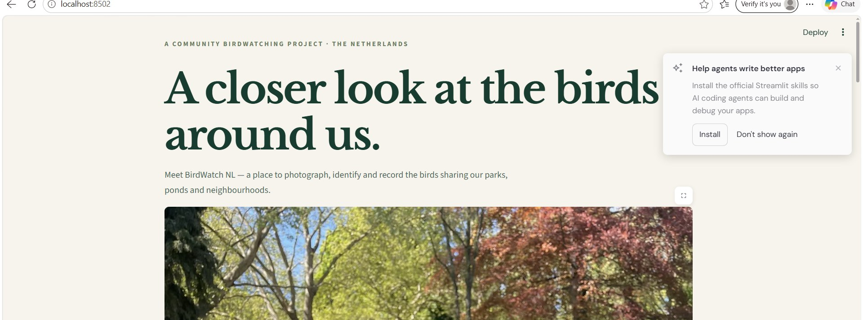
BIRDWATCH NL / SDG 15 — LIFE ON LAND
A closer look at the birds around us.
PHOTO → AI DETECTION → HUMAN REVIEW → SAVED OBSERVATION
1
Notes:
Introduce BirdWatch NL as a student-built, photo-based bird observation assistant for people in Dutch parks and neighbourhoods.

Slide 2
BIRDWATCH NL · HACKATHON
The problem: useful observations are hard to record
THE DUTCH CONTEXT
• Of 184 breeding-bird species, 82 declined and 88 increased (1990–2025).
• Among 27 characteristic farmland-bird species, 21 declined (1990–2024).
• Almost 2,000 volunteers and professionals contribute to Sovon waterbird monitoring.
THE SPECIFIC USER PROBLEM
Beginners photographing birds in Dutch parks and canals may struggle to identify broad bird groups, count individuals and keep a dated, organised record.
Sources: Compendium voor de Leefomgeving (2026a, 2026b); Sovon (n.d.). Figures describe different measures and periods.
2
Notes:
Source: https://www.sovon.nl/over-sovon and https://pub.sovon.nl/static/publicaties/Vogelbalans-2024_EN_LR.pdf. Do not claim the app itself measures population trends.

Slide 3
BIRDWATCH NL · HACKATHON
Who is BirdWatch NL for?
PRIMARY USER — A BEGINNER BIRDWATCHER
• Walks beside a canal or through a Dutch park; takes phone photos.
• Needs a first suggestion, a count and an easy observation log.
• May photograph distant, hidden or overlapping birds.
• Needs to review the AI rather than trust it blindly.
SECONDARY USERS
Students, teachers, families and local nature-education groups.
NOT FOR
Professional survey teams or official biodiversity trend estimation.
User need is a research-informed hypothesis; no beginner interviews or usability study have yet validated it.
3

Slide 4
BIRDWATCH NL · HACKATHON
The solution: a real end-to-end prototype
01
Upload a JPG/PNG bird photo
02
Roboflow AI identifies and counts birds
03
User checks and edits six species counts
04
Add date, location and optional notes
05
Save the record and export CSV
4
Notes:
Live demo: upload a photo, press Detect birds with AI, review the automatically filled counters, enter location and save.

Slide 5
BIRDWATCH NL · HACKATHON
Where the required AI tool is essential
ROBOFLOW
STREAMLIT + PYTHON
300-image labelled dataset
Trained object-detection model
Published cloud workflow
Returns bird class predictions
Uploads the photo to the workflow
Parses predicted species
Prefills editable counters
Saves records locally as CSV
Without Roboflow, the automatic identification and counting step would not exist.
5
Notes:
Avoid overstating model quality. The 300 images are the training dataset size visible in the project screenshot; no validation accuracy or comprehensive benchmark was provided.

Slide 6
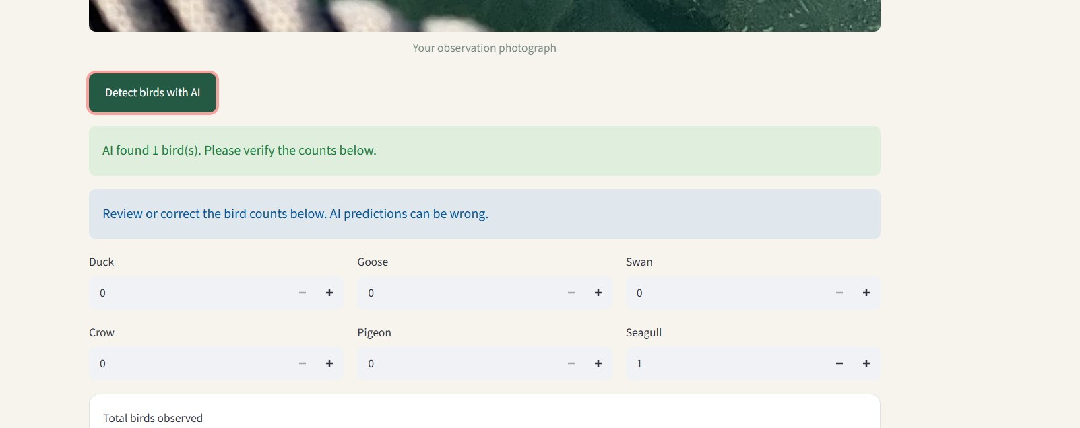
BIRDWATCH NL · HACKATHON
Proof 1 — the AI detected a seagull
Observed result: AI found 1 bird; Seagull = 1; other five classes = 0.
6
Notes:
This is a real screenshot of the working app, not a mock-up. The output is one example, not a claim of overall accuracy.

Slide 7
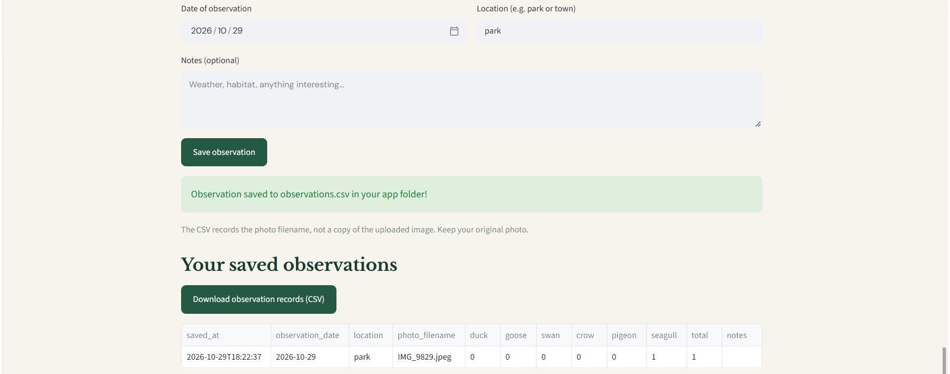
BIRDWATCH NL · HACKATHON
Proof 2 — the observation was saved
Observed record: 29 Oct 2026 · location “park” · seagull 1 · total 1 · CSV export available.
7
Notes:
Demonstrate the saved table and CSV download. The CSV stores a photo filename rather than the original photo.

Slide 8
BIRDWATCH NL · HACKATHON
Why this solution fits the problem
WHY THIS DESIGN FITS
• Photo upload meets users where they already start: with a phone picture.
• Roboflow gives a first detection and count of six broad bird groups.
• Editable counters keep the observer responsible for the final record.
• Date, general location, notes and CSV make sightings easier to organise.
EXISTING ALTERNATIVES
ObsIdentify already identifies nature from photos; Merlin/eBird can identify and locate birds. BirdWatch NL does not claim to be first. Its testable niche is a limited custom detector plus a simple correction-and-logging flow.
Research: Observation International (2026); eBird Support (2025). Whether beginners prefer this workflow remains untested.
8

Slide 9
BIRDWATCH NL · HACKATHON
Ethics: the risks are specific to this app
RISK → CONSEQUENCE → MITIGATION
• Wrong bird groups/counts → misleading records → warning + editable counts (implemented); test on unseen photos (next).
• Uneven classes/backgrounds → biased predictions → inspect per-group performance, add diverse examples (next).
• Unsupported birds (e.g., Eurasian coot) → wrong label → state the six-group scope; never relabel a coot as a duck.
• People or sensitive nest locations in photos → privacy/disturbance → use broad locations, avoid identifiable people and nests.
• Roboflow cloud processing → photos leave the device → inform users; keep API keys out of GitHub.
Also respect wildlife and image ownership: do not disturb birds, and use permitted/self-collected training photos.
9
Notes:
Distinguish implemented controls from proposed improvements. Current app warns about AI errors, allows manual correction, and discloses cloud transfer; further safeguards are future work.

Slide 10
BIRDWATCH NL · HACKATHON
What works — and what remains unproven
DEMONSTRATED IN THE APP
• Local Streamlit website and working Roboflow workflow.
• One uploaded image produced a prediction: one seagull.
• User can correct six broad-group counts.
• Date, location and notes can be saved to CSV; export works.
NOT YET ESTABLISHED
• Precision/recall or counting error on unseen images.
• Performance on distant birds, reflections or groups.
• Benefit to beginners compared with doing the task manually.
• Suitability for scientific surveys or official SDG reporting.
Next test: unseen photos by group; count error and false detections; 3–5 beginner usability sessions.
10

Slide 11
BIRDWATCH NL · HACKATHON
Sources & acknowledgement
DESK RESEARCH — KEY REFERENCES
Compendium voor de Leefomgeving (2026a). Farmland fauna, 1990–2024.
https://www.clo.nl/indicatoren/nl158010-fauna-van-het-agrarisch-gebied-1990-2024
Compendium voor de Leefomgeving (2026b). Breeding birds, 1990–2025.
https://www.clo.nl/indicatoren/nl138121-trend-van-broedvogels-1990-2025
Sovon (n.d.). Waterbird counts. https://www.sovon.nl/tellen/telprojecten/watervogeltelling
Sovon (2024). State of Birds in the Netherlands 2024.
United Nations (n.d.). SDG 15. https://sdgs.un.org/goals/goal15
Observation International (2026). ObsIdentify; eBird Support (2025). Merlin Photo ID.
Full reference list and research rationale: BirdWatch_NL_Desk_Research_Humanized.pdf
13

